Slide 1
ChannelFinder: A directory service

Slide 2
Motivation and Objectives
A flat name space restricts seriously:
Clients need to know all channel names beforehand
Portable generic clients must be simple
Apps need full configuration or framework supplied service
Develop a Directory Service
Generic
No dependency on installation and local conventions
Simple and fast (enough)
Use standards wherever possible
Provides "query-by-functionality"

Slide 3
Publish/subscribe
Command/response
v3
v4
IOC
IOC
…
IOC
IOC
…
v4
CA client (JCA/CAJ)
pvA client
Masar
…
Core Client Technologies
Data Sources
CA
Sim
Test
pvA
Aggregation
pvManager
AccelUtils
Java/Python
Web based REST services
Data Definition
vTypes
API
ChannelFinder
Visualization
Graphene
API
Olog
CSS Core
ChannelFinder Integration
Olog Integration
…
...
…
BOY
Web UI and other clients
Scripts and utilities
DataBrowser
Logbook
cf-update
CSS
…
…

Slide 4
ChannelFinder Data
Set of Channels (unique names)
Each Channel has an arbitrary number of Properties (name/value pairs) and Tags (names)
Each Channel, Property, or Tag has an Owner (group) to allow basic access control
All names and values are strings

Slide 5
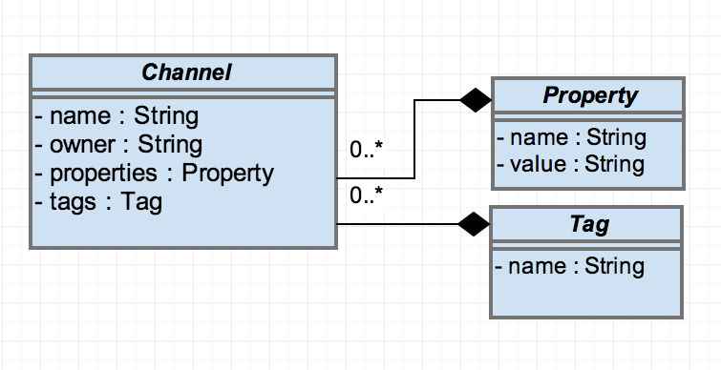
Directory Data

Slide 6
Channel example
"name":"XF:31IDA-OP{Tbl-Ax:X1}Mtr",
"owner":"train",
"properties":
["handle":"Setpoint",
"axis":"1",
"hostname":"training.org.epics",
"iocName":"motorsim",
"time":"2016-03-21"]
"tags":
["motor",
"sys.XF:31"
]

Slide 7
Query Example
XF:31*IDA*
All pvs from the insertion device 31
XF:31*IDA*&axis=4*
All pvs from the insertion device 31 belonging to axis 4
XF:31*IDA*&axis=4*&pvStatus=active
All pvs from the insertion device 31 belonging to axis 4
and with pvStatus active
XF:31*IDA*&axis=4*&tag=aphla.sys.SR
All pvs from the insertion device 31 belonging to axis 4
with tag sys.XF:31

Slide 8
Example Data set

Slide 9
device FM1G4C02A
Channel Name | SR:C02-MG:G04A{HFCor:FM1} |  | SR:C02-MG:G04A{VFCor:FM1}
 | Fld-I | Fld-SP | Fld-I | Fld-SP
handle | READBACK | SETPOINT | READBACK | SETPOINT
elemName | FXM1G4C02A |  | FYM1G4C02A
elemType | HFCOR |  | VFCOR
elemField | x |  | y
devName | FM1G4C02A
sEnd | 65.5222
cell | C02
girder | G4
symmetry | A
length | 0.044
ordinal | 263 |  | 264
tags | eget | eput | eget | eput
 | x |  | y
 | sys.SR

Slide 10
device FM1G4C02A
Channel Name | SR:C02-MG:G04A{HFCor:FM1} |  | SR:C02-MG:G04A{VFCor:FM1}
 | Fld-I | Fld-SP | Fld-I | Fld-SP
hostName | ps-psioc-c02.cs.nsls2.local
iocName | ps-C02A
updateTime | 2015-03-13
active | True
Tags | archive

Slide 11
Usage from high level physics
Example*
corrector = Corrector(deviceName=`FM1G4C02A`)
>> channels = cf.find(deviceName=‘FM1G4CO2A’)
xPos, yPos = corrector.getPositions()
>> xPosPv = cf.find([(deviceName,‘FM1G4CO2A’), (elemField, ‘x’)])
>> yPosPv = cf.find([(deviceName,‘FM1G4CO2A’), (elemField, ‘y’)])
>> caget(xPosPv ) and caget(yPosPv )
corrector.setPositions(xPos=1.23, yPos=3.21)
```caput(‘SR:C02-MG:G04A{HFCor:FM1} Fld-SP’, 1.23) and caput(‘SR:C02-MG:G04A{VFCor:FM1} Fld-SP’, 3.21)```
Notes:
High level applications (HLA) deals with thousands of magnets, instruments and more channels.
Organized/structured channel information is necessary.
Channels linked to accelerator lattice and diagnostics are even better.
Searching instead of remembering is easier for HLA users.

Slide 12
Performance Environment
Database
150k channels
40 properties
60 tags
Queries
Search using wildcards for channel names and property values
Result Size
Each channel is 1127 bytes

Slide 13
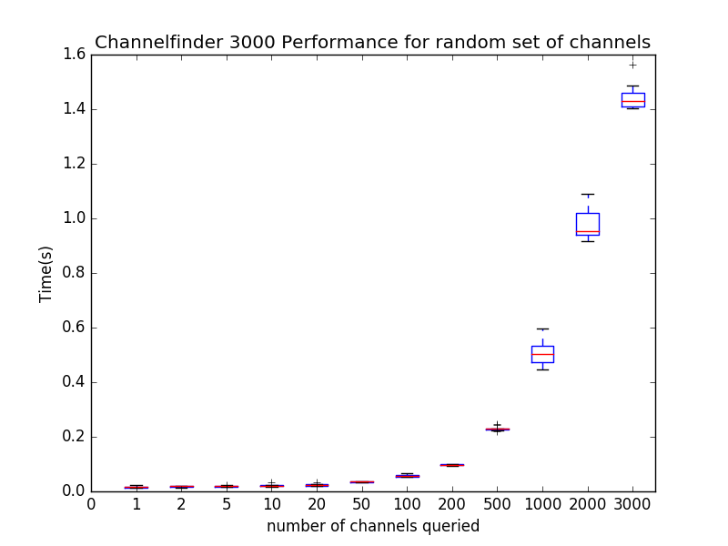
CF v3: Large Queries

Slide 14
Populating ChannelFinder

Slide 15
Recsync : cfStore
How to add new channels
Without having to learn the client api's
How to manage existing channels
Orphaned channels
Moved channels

Slide 16
Recsync : cfStore
The record synchronizer
A client (RecCaster) which runing as part of an EPICS IOC (EPICS support module)
A server (RecCeiver) which is a stand alone daemon.
Together they work to ensure the the server(s) have a complete list of all records currently provided by the client IOCs.
Recsync Information
The EPICS Base Version
A white listed set of environment variables
The name and type of all records
Any info() tags associated with these records
https://github.com/mdavidsaver/recsync

Slide 17
Recsync : cfStore
The properties currently managed with cfStore
hostName
iocName
pvStatus : Active or InActive
time : The last time the above properties were updated

Slide 18
cf-properties
Python script part of the CFPropertyManager which populates CF properties using the sites naming convention.
>> CFPropertyManager hostName.iocName.dbl property.cfg
hostName.iocName.dbl
The output of the dbl command
property.cfg
A configuration file which defines a list of property name and their corresponding regular expression
e.g.
devName=[{][^:}][^:}]*
devType=[:][^{]*?[:}](?!.*[{])
Thanks to Michael Skinner

Slide 19
Channel Finder CSS Applications demo
4:26 minutes

Slide 20
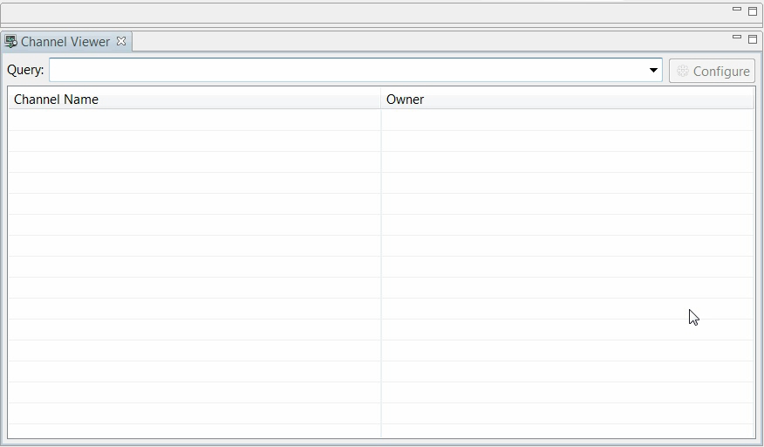

Slide 21
ChannelFinder in CSS
Quick demo of the ChannelFinder applications

Slide 22
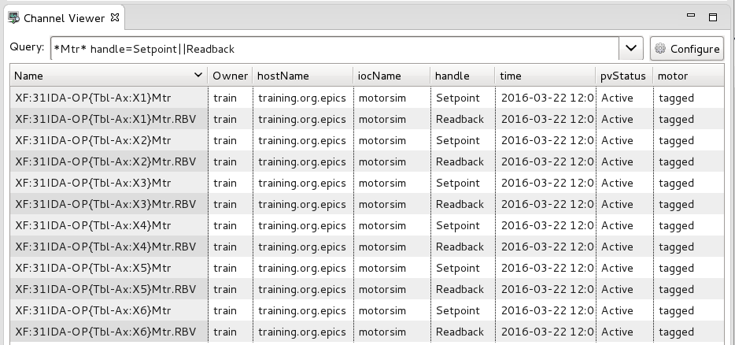
ChannelViewer
CS-Studio → Display → ChannelViewer

Slide 23
ChannelViewer
Query can be construted for the Name, Property value, Tags associated with channels
Wildcard character like "*", "?" can be used in the queries
prop=val1||val2 is equivalent to prop=val1 OR prop=val2
prop=val1 tag=myTag is equivalent to prop=val1 AND tag=myTag

Slide 24
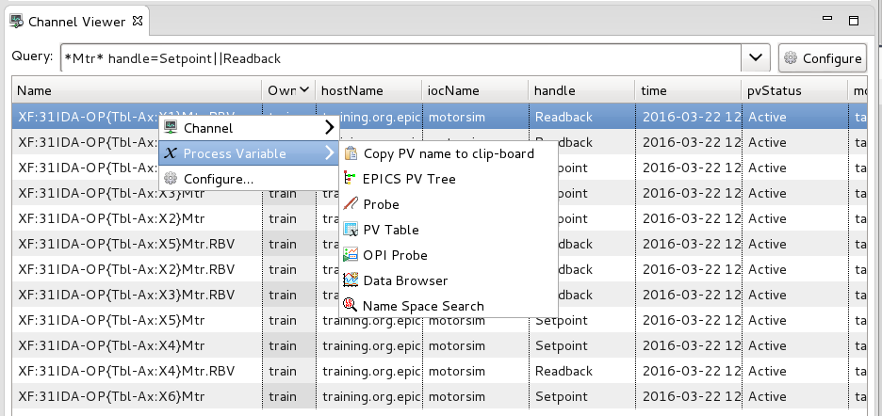
ChannelViewer
Channel/s can be forwarded to other cs-studio applications

Slide 25
ChannelViewer
Channel/s can be forwarded to other cs-studio applications

Slide 26
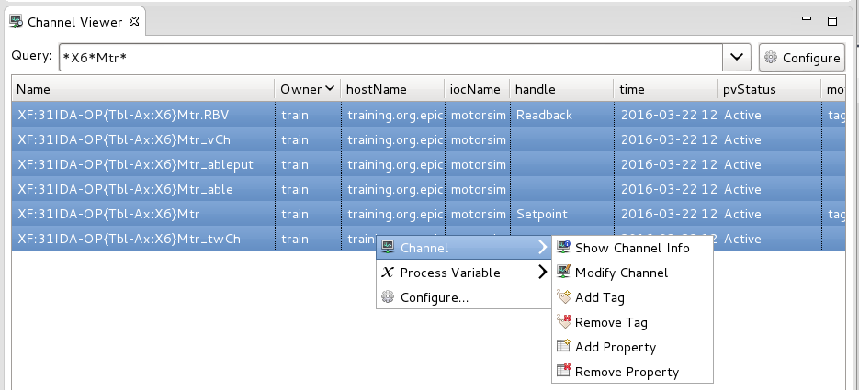
ChannelViewer - editing
Add a tag/property to a channel or a group of channels
Remove a tag/property from a channel or a group of channels

Slide 27
ChannelViewer - editing
Query *X6*Mtr to select all the channels for associated with motor6
Select all pv’s and choose "add property"

Slide 28
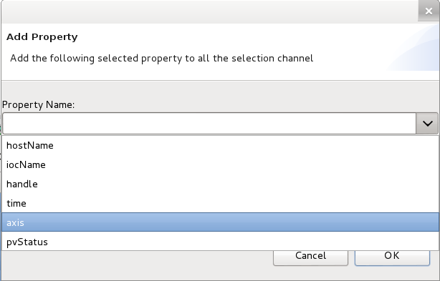
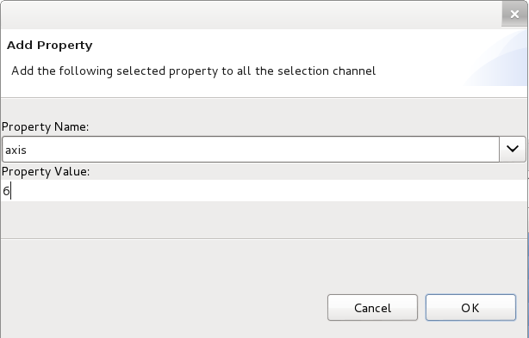
ChannelViewer - editing
Select the property "Axis" from the listed properties.
Enter a value for the property e.g. “X6"

Slide 29
Channel Tree
Channel Tree by Property allows to create an hierarchical view of the channels by using properties and their values.

Slide 30
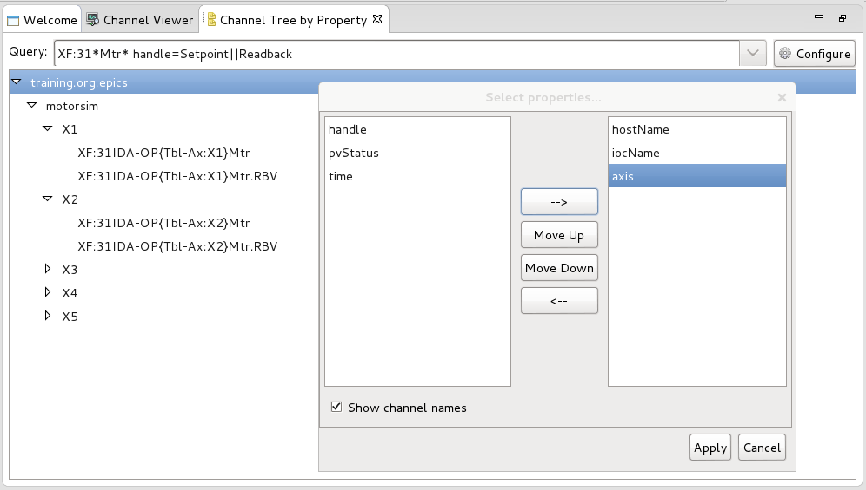
Channel Tree
Query: XF:31*Mtr* handle=Setpoint||Readback
Configure the tree by selecting the properties to be used to create the hierarchy (hostname, handle, axis,…)
Notes:
Exercise: create the tree

Slide 31
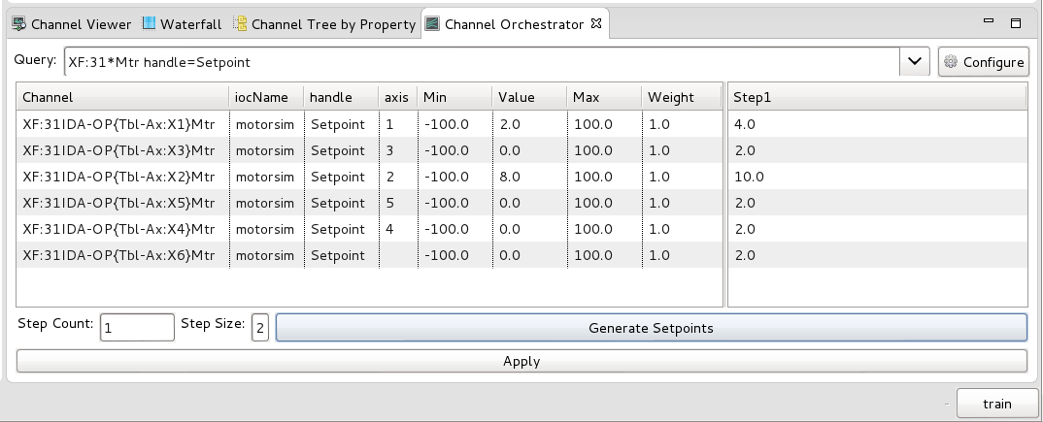
Channel Orchestrator
The channel orchestrator is a tool to assist in preparing and writing a group of set points

Slide 32
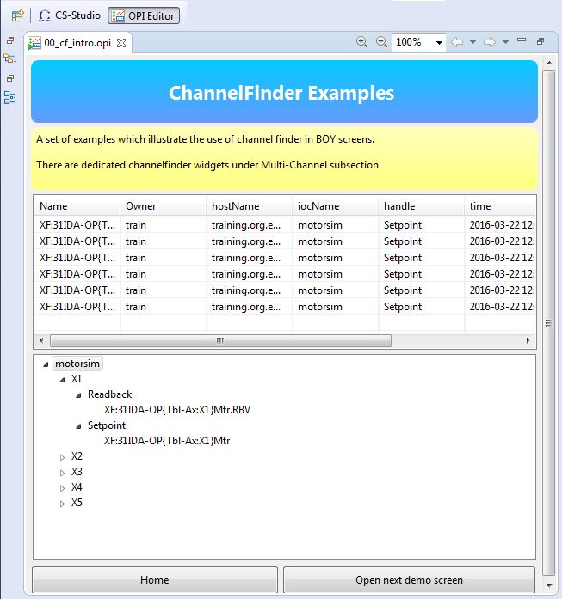
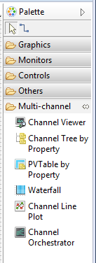
ChannelFinder & BOY
Dedicated ChannelFinder widgets
Notes:
channelviewer

Slide 33
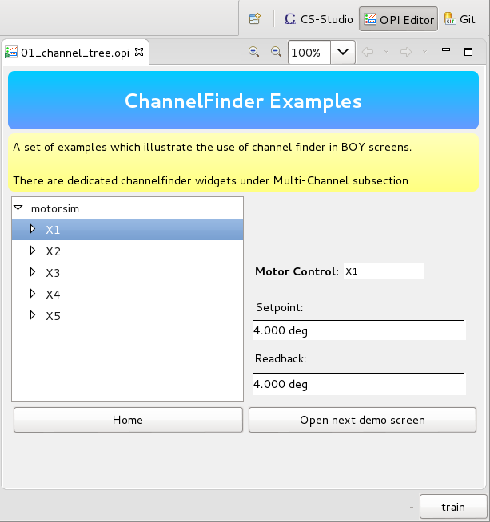
ChannelFinder & BOY
Embed channel tree by property widget into the opi
Set Channel query: “XF:31*Mtr*”
Tree Properties: iocName, axis, handle
Selection Expression: #(axis)
Selections from this widget can be used to initialize other widgets

Slide 34
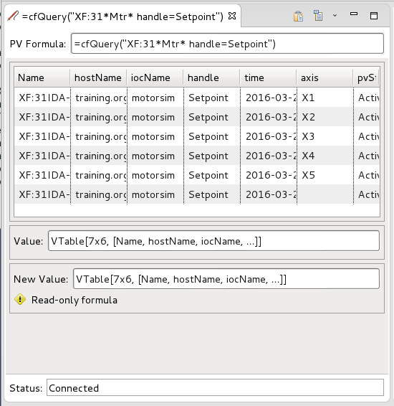
cfQuery
Accessing channelfinder data in opi screens
=cfQuery(Vstring query) : VTable

Slide 35
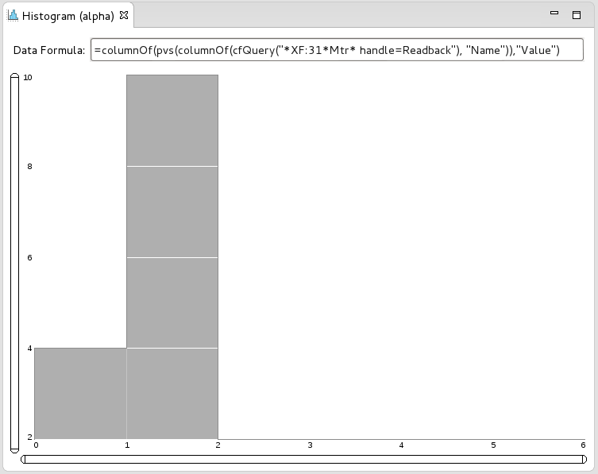
cfQuery
Combining cfQuery with other formulas to create tables/arrays which can be then used with existing cs-studio widgets
=columnOf(pvs(columnOf(cfQuery("*XF:31*Mtr* handle=Readback"), "Name")),"Value")

Slide 36
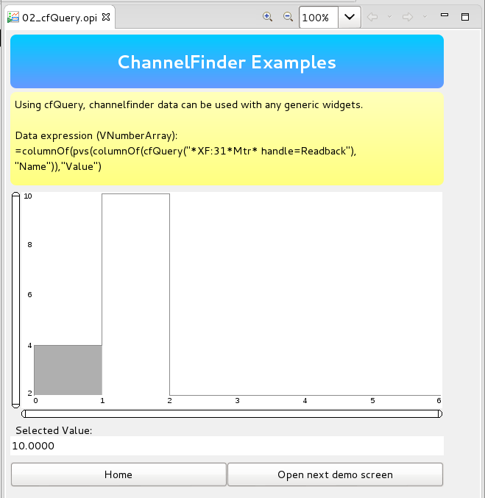
ChannelFinder & BOY
Notes:
Orchestrator and histogram

Slide 37
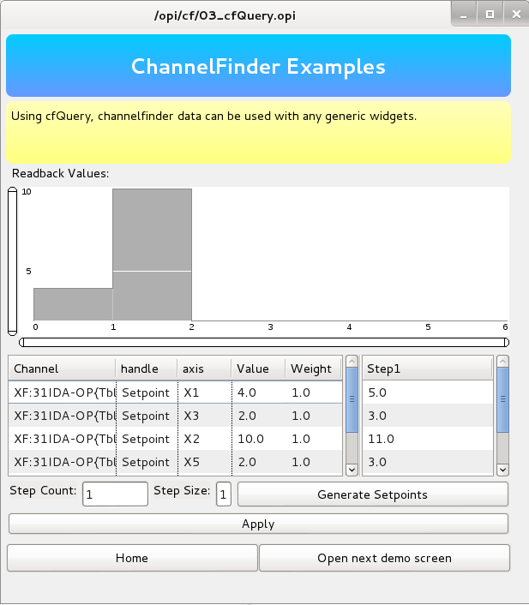
ChannelFinder & BOY
Notes:
Orchestrator and histogram

Slide 38
PVA ChannelFinder in CSS
EPICS7 directory service

Slide 39
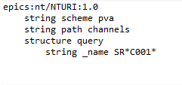
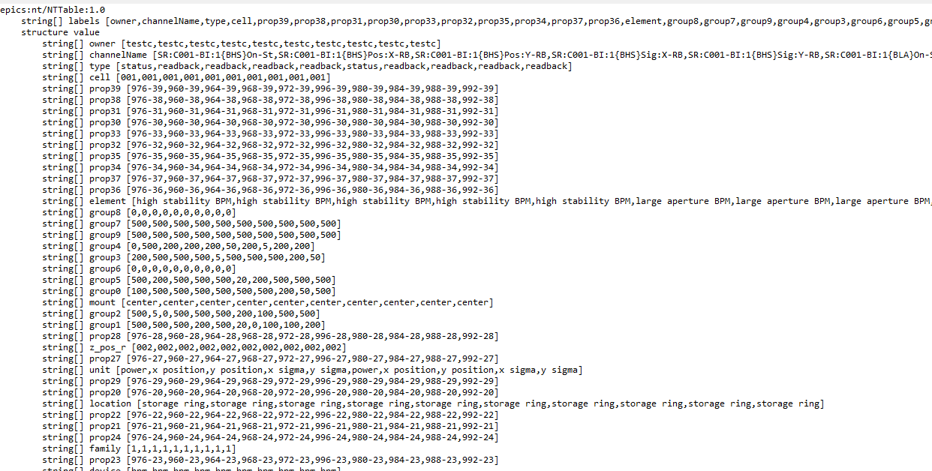
pvaChannelFinder
A EPICS7 RPC service
Request is a NTURI
name, tag, or property value
* & % wildcard chars
Result is a NTTable
List of all the matching channels and their associated properties and tags

Slide 40
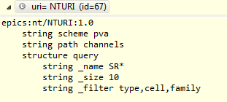
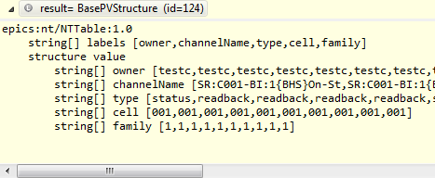
pvaChannelFinder
Filtering
The query defines the tags and properties to be included in the result
Improves performance

Slide 41
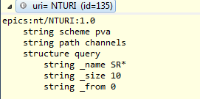
pvaChannelFinder
Pagination
The result can be fetched in parts using the _size and _from arguments
Results in the creation for more robust and responsive clients

Slide 42
Questions

